Slide 1
DevOps ext program Winter 2020-2021
Creating basic DevOps chain connecting local machine, GitHub repository, Jenkins and GCP instance.
Andrii Kozak

Slide 2
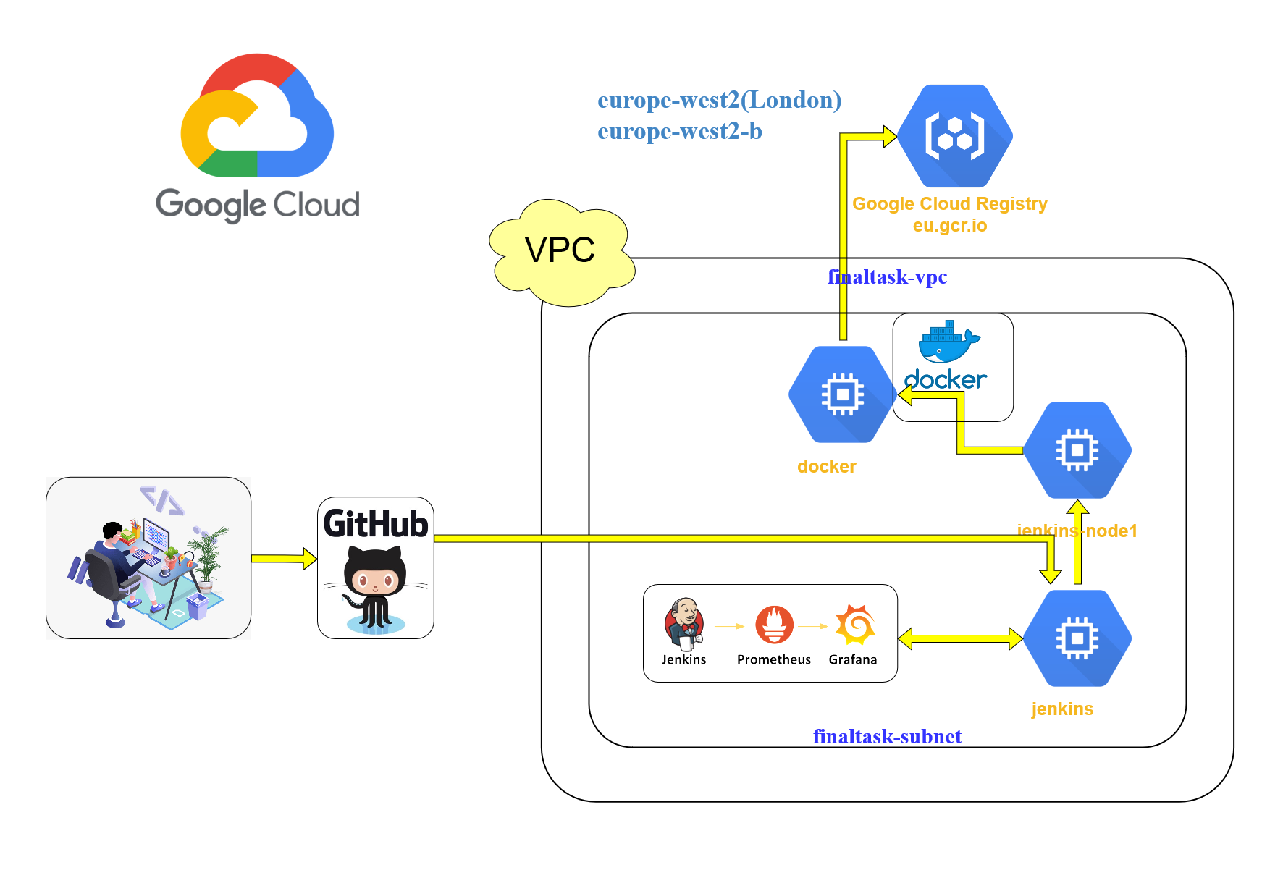
Final task diagram

Slide 3
Task descriptions
Automated and fast deployment site to server after changes.
In project we used:
Google Cloud Platform;
GitHub;
Jenkins;
Terraform;
Bash scripts;
Docker, docker-compose;
Django;
Bonus+: Prometheus, Grafana.

Slide 4
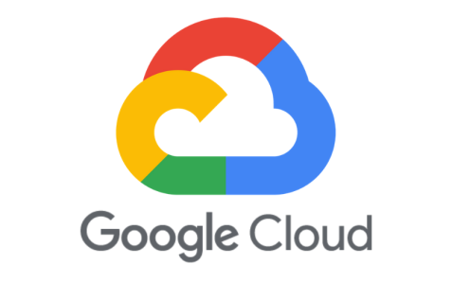
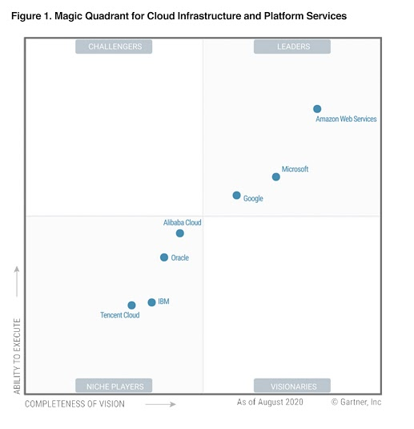
Google Cloud Platform
Google Cloud Platform (GCP), offered by Google (company), is a suite of cloud computing services that runs on the same infrastructure that Google uses internally for its end-user products, such as Google Search, Gmail, file storage, and YouTube. Alongside a set of management tools, it provides a series of modular cloud services including computing, data storage, data analytics and machine learning.

Slide 5
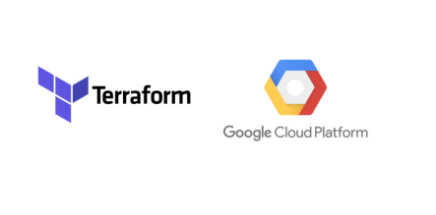
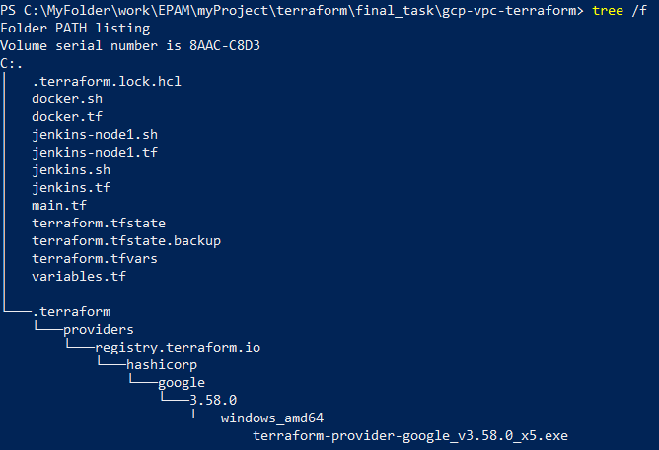
Terraform
Terraform is an open-source infrastructure as code software tool created by HashiCorp. Users define and provision data center infrastructure using a declarative configuration language known as HashiCorp Configuration Language (HCL), or optionally JSON.

Slide 6
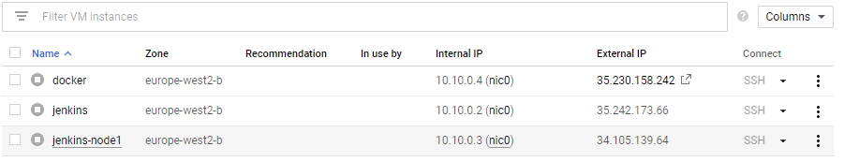
Terraform
main.tf – create VPC, Subnetwork, VPC firewall configuration.
docker.tf – create instance docker ( docker.sh – install docker, docker-compose).
jenkins.tf – create instance jenkins ( jenkins.sh –install Java, jenkins, docker, docker-compose).
Jenkins-node1.tf – create instance jenkins-node1 ( jenkins-node1.sh – install Java).
All instances have static IP.

Slide 7
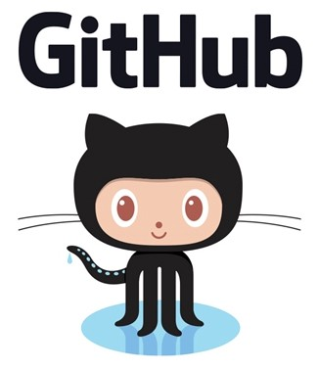
GitHub
GitHub, Inc. is a provider of Internet hosting for software development and version control using Git. It offers the distributed version control and source code management (SCM) functionality of Git, plus its own features. It provides access control and several collaboration features such as bug tracking, feature requests, task management, continuous integration and wikis for every project. Headquartered in California, it has been a subsidiary of Microsoft since 2018.

Slide 8
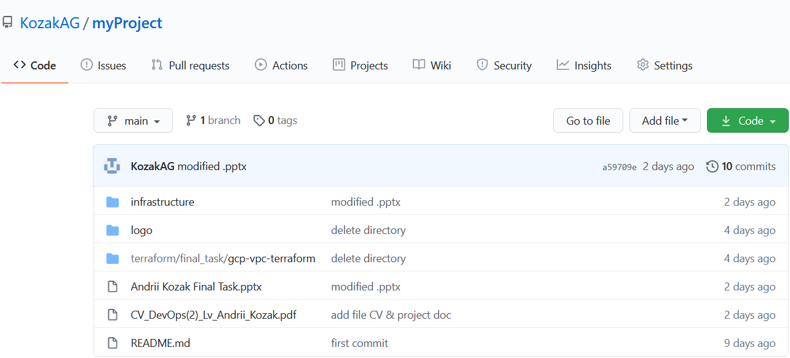
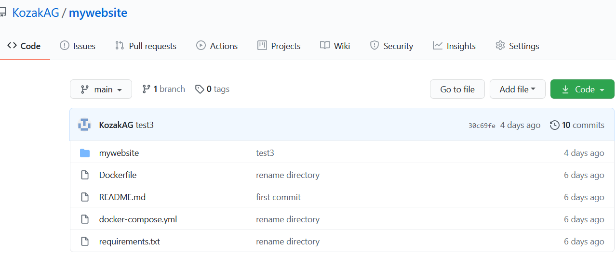
GitHub
We create the following repositories:

Slide 9
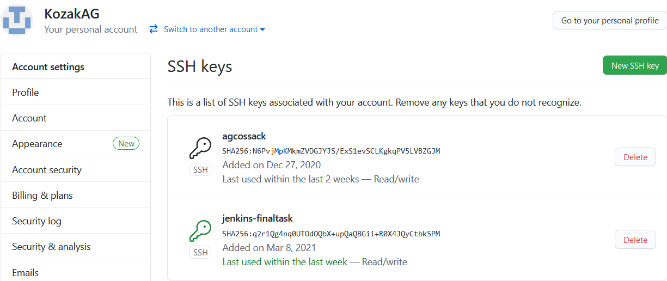
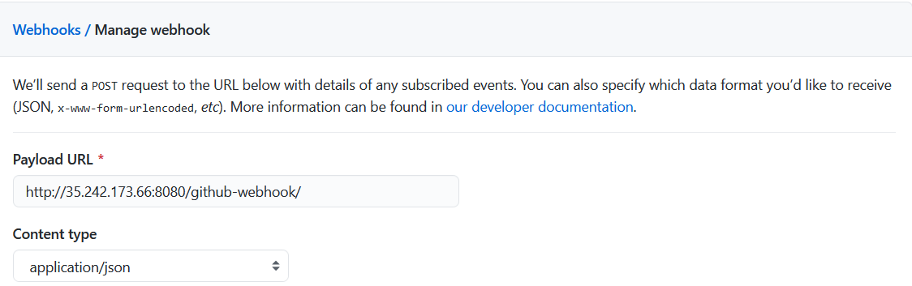
GitHub
We add the ssh keys to the repository:
We add webhook to the repository

Slide 10

Jenkins
Jenkins is a free and open source automation server. It helps automate the parts of software development related to building, testing, and deploying, facilitating continuous integration and continuous delivery. It is a server-based system that runs in servlet containers such as Apache Tomcat. It supports version control tools, including AccuRev, CVS, Subversion, Git, Mercurial, Perforce, ClearCase and RTC, and can execute Apache Ant, Apache Maven and sbt based projects as well as arbitrary shell scripts and Windows batch commands.

Slide 11
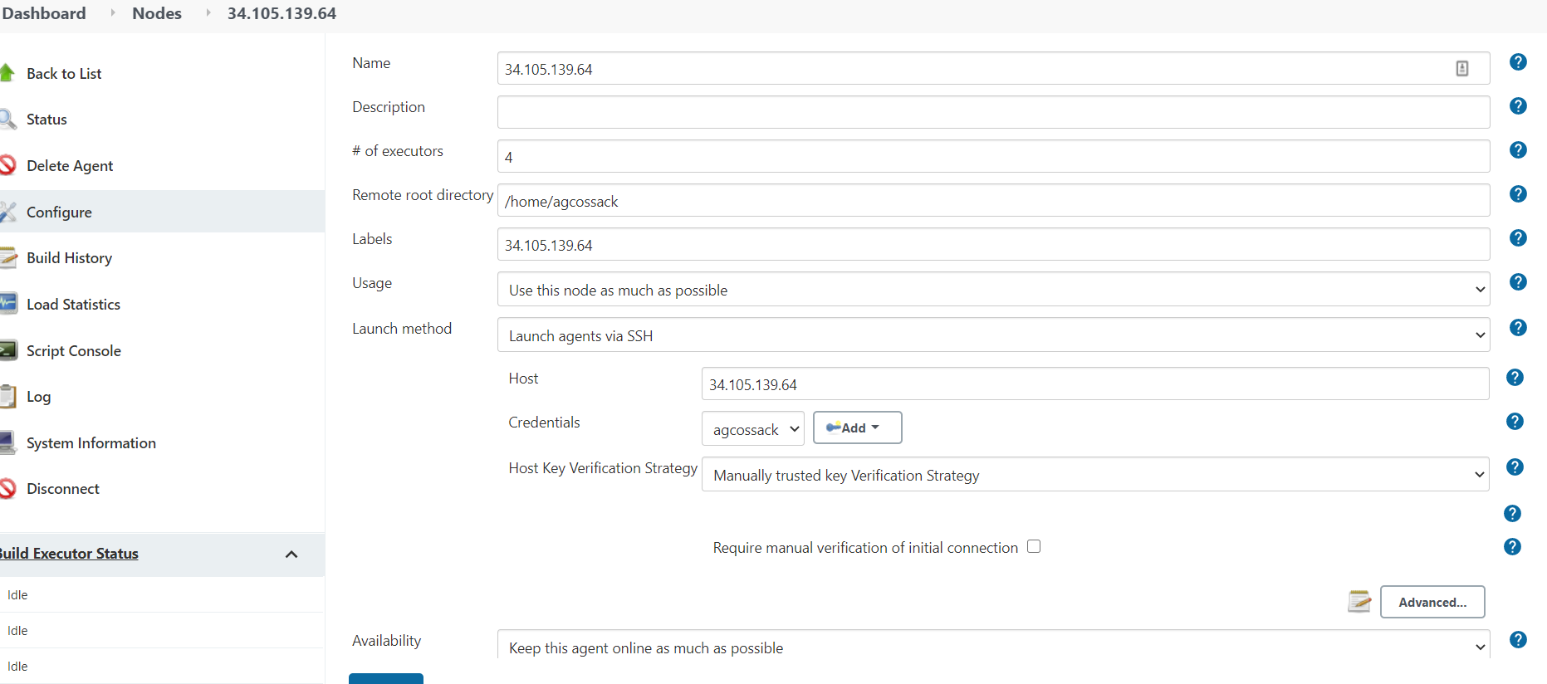
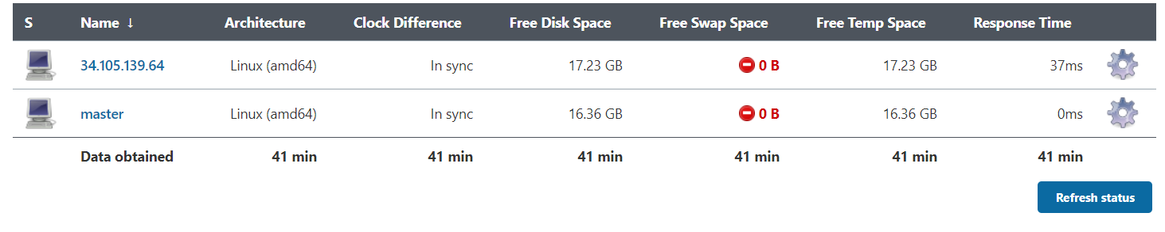
Jenkins
Configure node1 (slave)

Slide 12
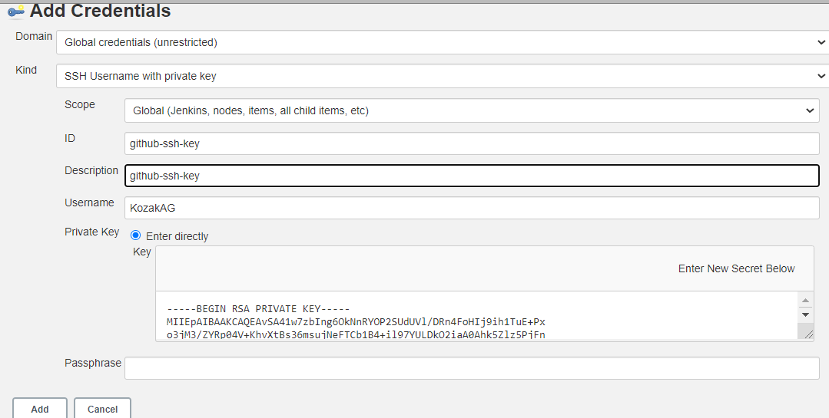
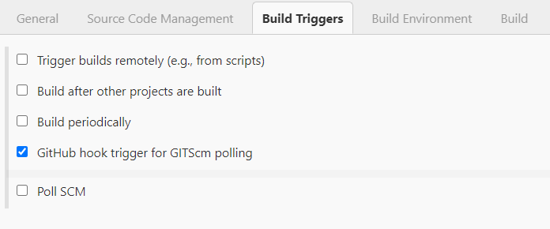
Jenkins
Configure our job: finaltask.

Slide 13
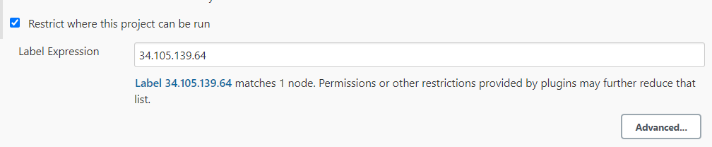
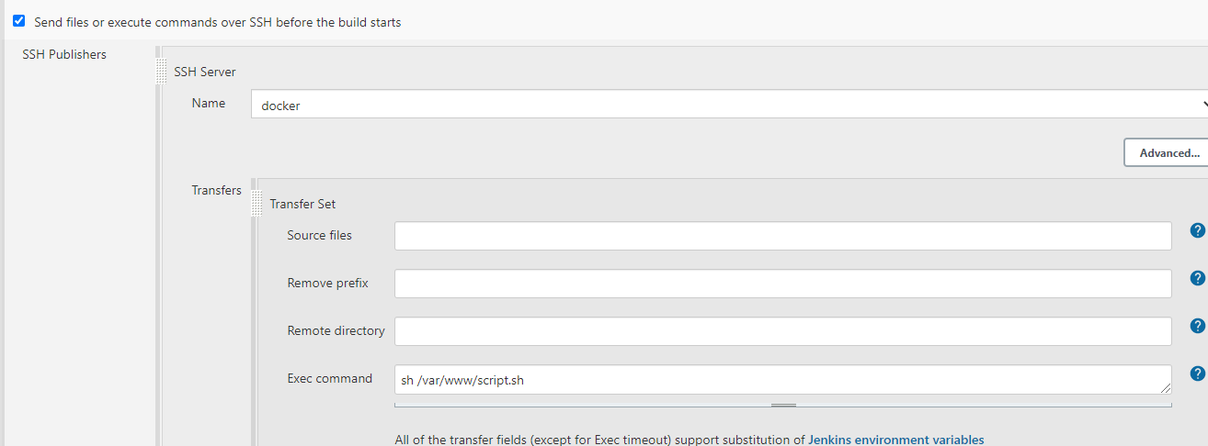
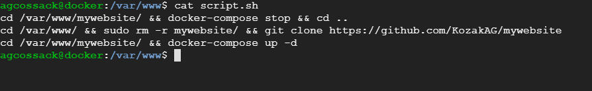
Jenkins
Configure our job: finaltask.

Slide 14

Prometheus
Prometheus is a free software application used for event monitoring and alerting. It records real-time metrics in a time series database (allowing for high dimensionality) built using a HTTP pull model, with flexible queries and real-time alerting. The project is written in Go and licensed under the Apache 2 License, with source code available on GitHub, and is a graduated project of the Cloud Native Computing Foundation, along with Kubernetes and Envoy.

Slide 15
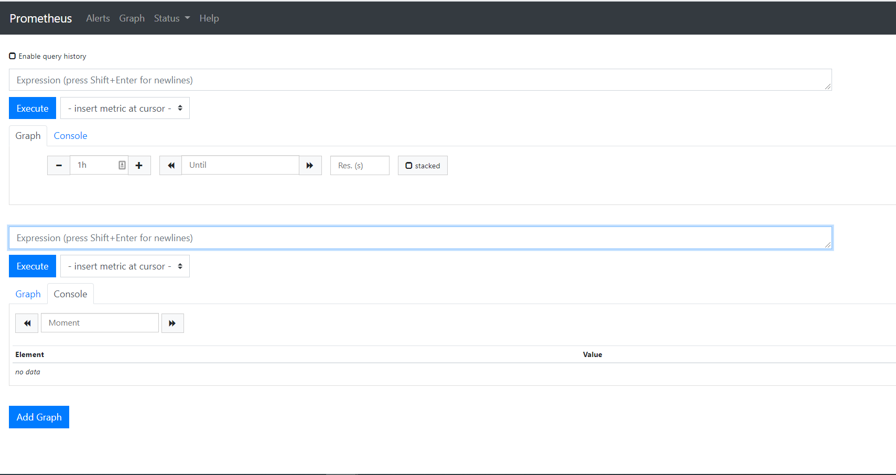
Prometheus

Slide 16

Grafana
Grafana is a multi-platform open source analytics and interactive visualization web application. It provides charts, graphs, and alerts for the web when connected to supported data sources. Grafana Enterprise version with additional capabilities is also available. It is expandable through a plug-in system. End users can create complex monitoring dashboards using interactive query builders.

Slide 17
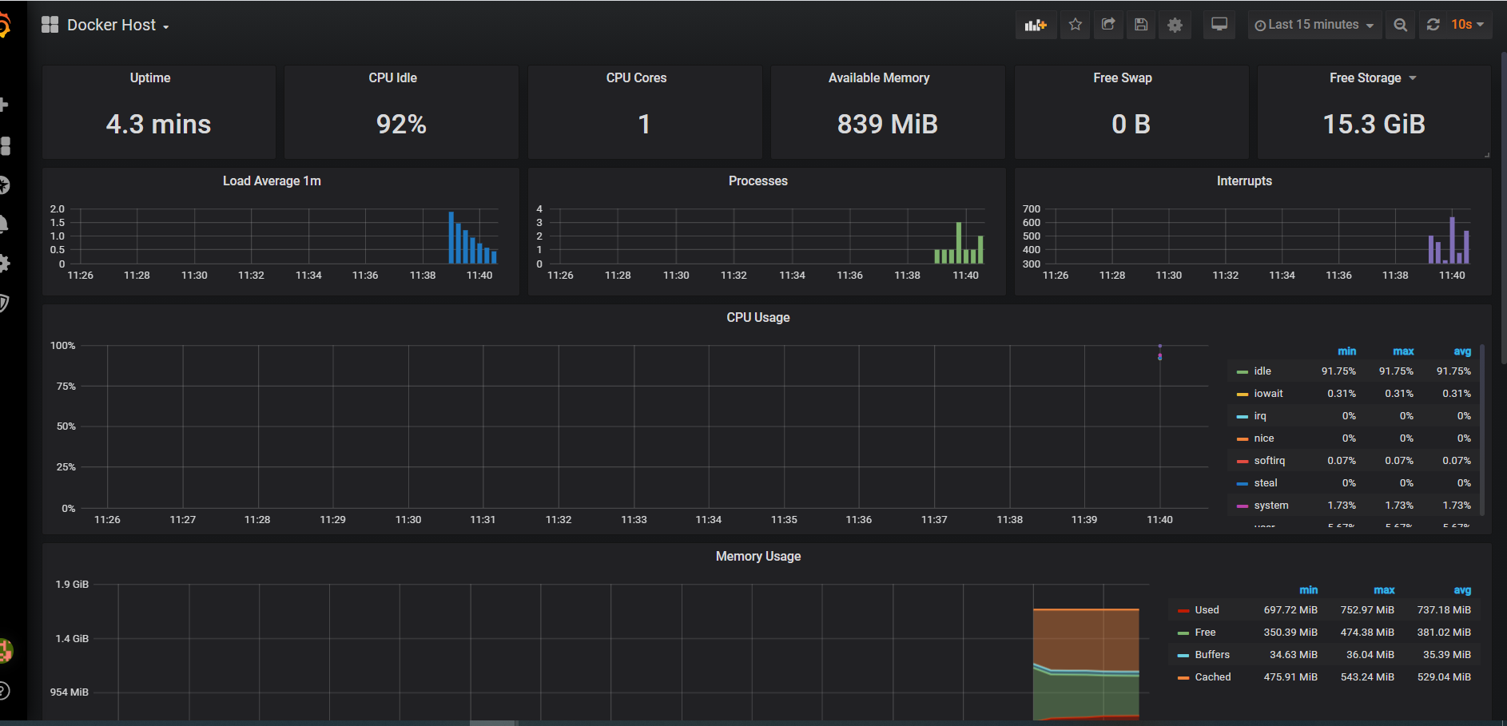
Grafana

Slide 18
Prometheus + Grafana install
We will use Einsteinish/Docker-Compose-Prometheus-and-Grafana, which includes Prometheus, Grafana, cAdvisor, NodeExporter and AlertManager.
Clone the repository and run the installation:
git clone https://github.com/Einsteinish/Docker-Compose-Prometheus-and-Grafana.git
cd Docker-Compose-Prometheus-and-Grafana
docker-compose up -d

Slide 19
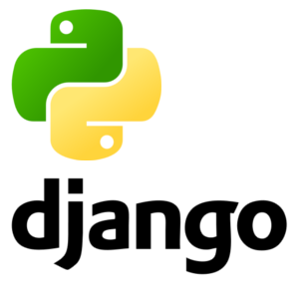
Django
Django is a Python-based free and open-source web framework that follows the model-template-views (MTV) architectural pattern.
Django's primary goal is to ease the creation of complex, database-driven websites. The framework emphasizes reusability and "pluggability" of components, less code, low coupling, rapid development, and the principle of don't repeat yourself. Python is used throughout, even for settings, files, and data models. Django also provides an optional administrative create, read, update and delete interface that is generated dynamically through introspection and configured via admin models.

Slide 20
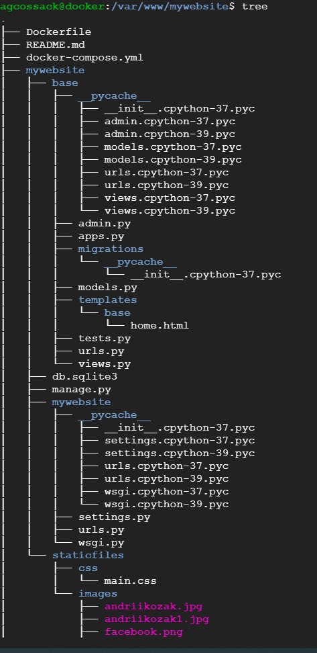
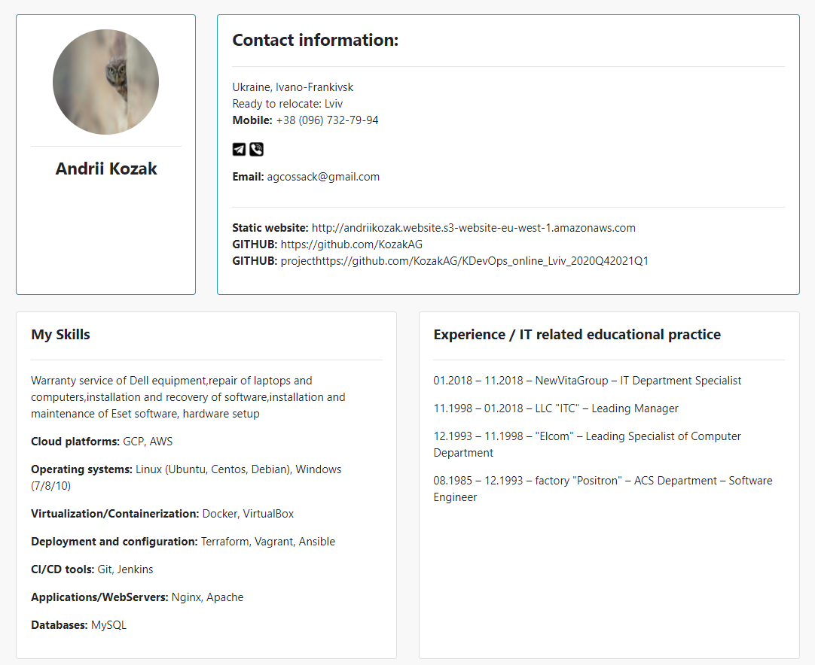
Django

Slide 21
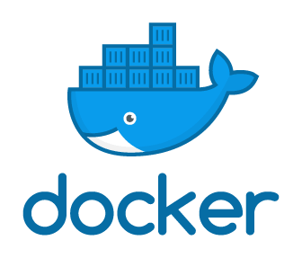
Docker
Docker is a set of platform as a service (PaaS) products that use OS-level virtualization to deliver software in packages called containers.
Containers are isolated from one another and bundle their own software, libraries and configuration files; they can communicate with each other through well-defined channels. Because all of the containers share the services of a single operating system kernel, they use fewer resources than virtual machines.
The service has both free and premium tiers. The software that hosts the containers is called Docker Engine.

Slide 22
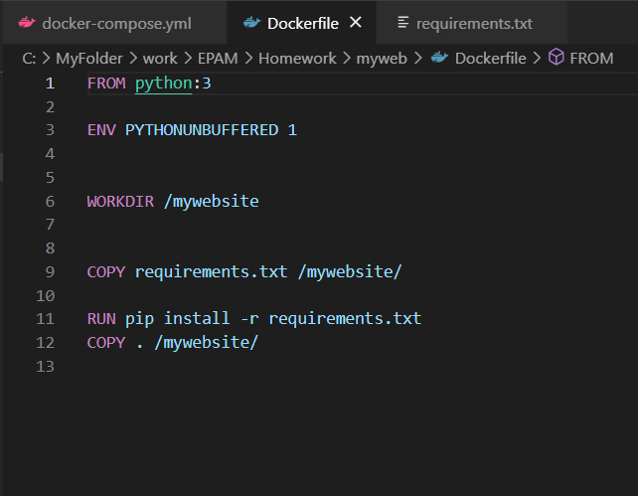
Docker
Add the following content to the Dockerfile.
This Dockerfile starts with a Python 3 parent image. The parent image is modified by adding a new code directory.

Slide 23
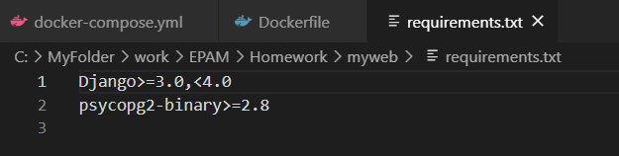
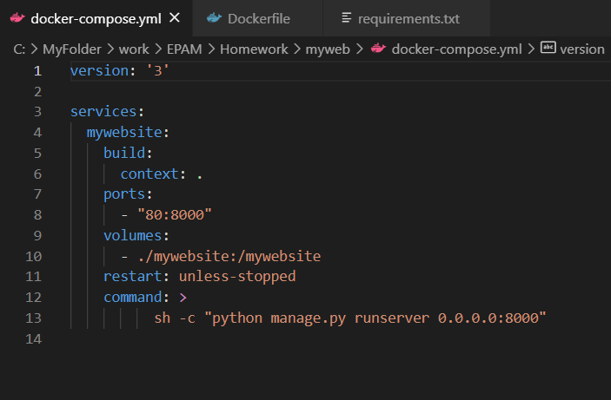
Docker
The parent image is further modified by installing the Python requirements defined in the requirements.txt file.
The docker-compose.yml file describes the services that make our app. In this example those service is a web server.
The compose file also describes which Docker image this service use, which volume need to be mounted inside the container.
Finally, the docker-compose.yml file describes which ports this service expose.

Slide 24
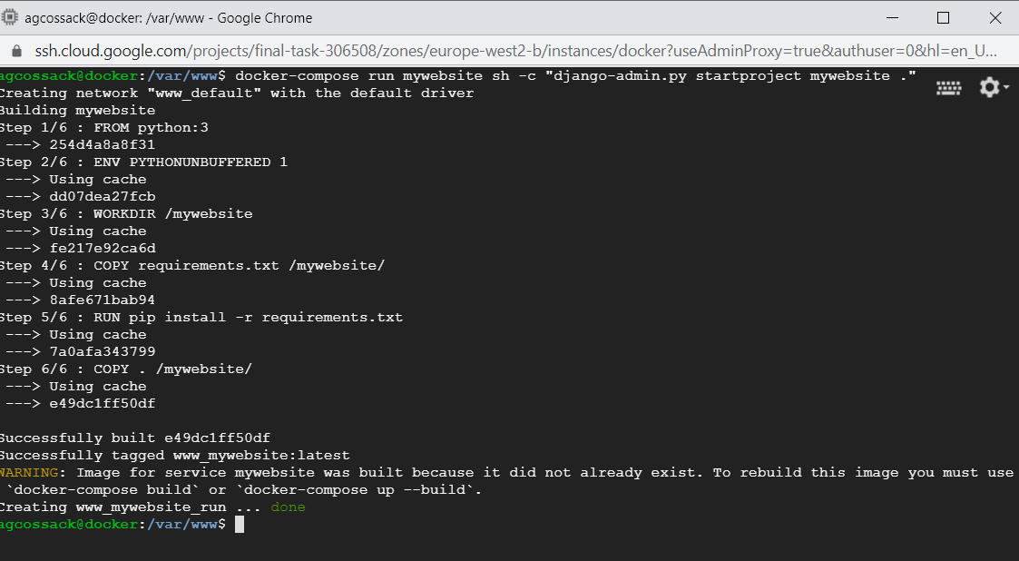
Docker
We create the Django project by running the docker-compose run command as follows.

Slide 25
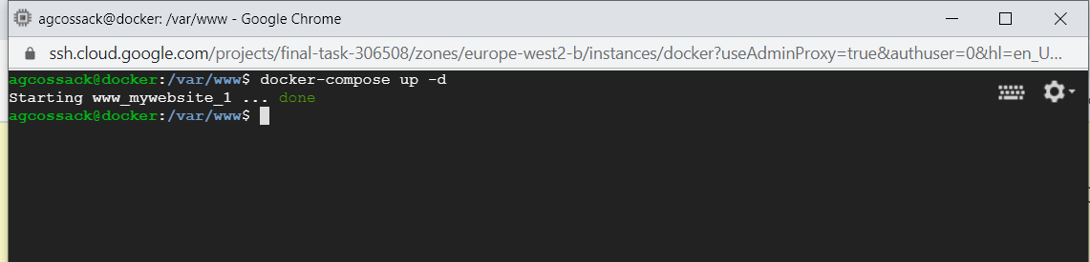
Docker
Change the ownership of the new files.
sudo chown -R $USER:$USER .
Run the docker-compose up command from the top level directory for your project.
docker-compose up -d

Slide 26
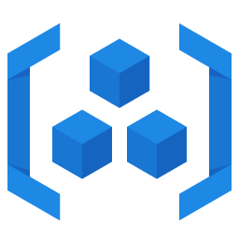
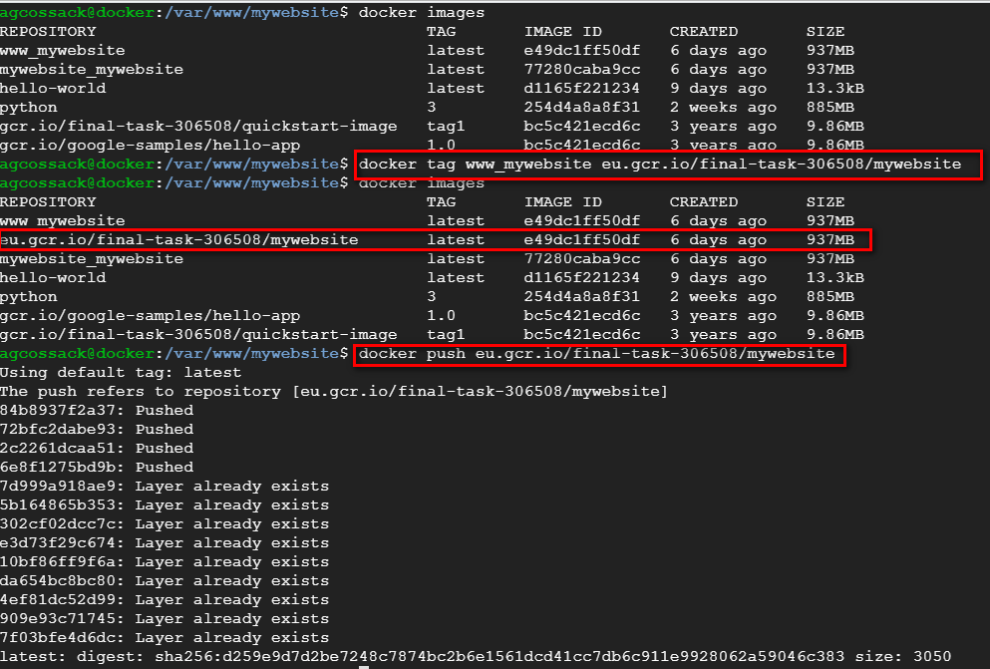
GCR.IO
Container Registry is a single place for your team to manage Docker images, perform vulnerability analysis, and decide who can access what with fine-grained access control. Existing CI/CD integrations let you set up fully automated Docker pipelines to get fast feedback.

Slide 27
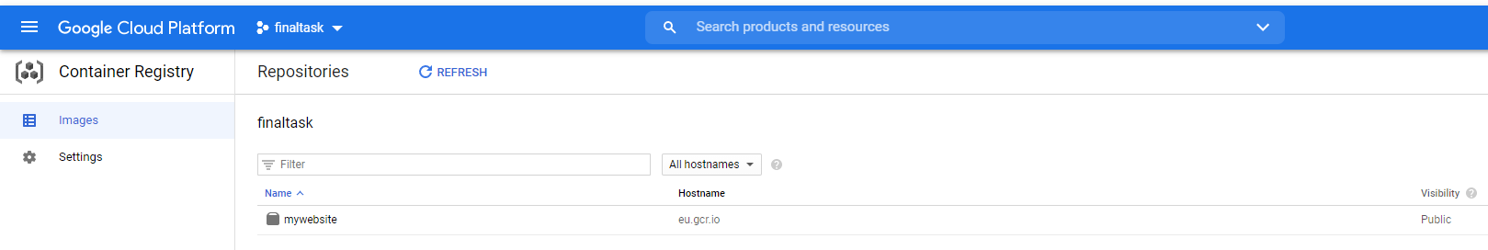
GCR.IO

Slide 28
Thanks for attention!
Student: Andrii Kozak
Email: agcossack@gmail.com

